Slide 1
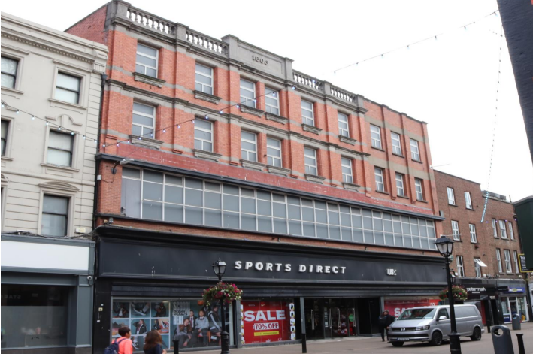
Unit 19-22, North Earl Street, Dublin
Unit 19-22, North Earl Street, Dublin
To let (by way of assignment)
Property Highlights
Prime Dublin City Centre location on pedestrian part of North Earl Street
Landmark retail building extending to a gross floor area of approx. 4,832 sq.m. (52,011 sq.ft.) over basement, ground and three upper floors.
Dual frontage with main access to North Earl Street and secondary access via Marlborough Street.
Extensive frontage to North Earl Street of c18m.
Contact
Location
The property occupies a prime position on the pedestrianised section of North Earl Street in Dublin City Centre, close to O’Connell Street, Marlborough/Talbot Street and Henry Street. The area is a well-established retail destination with major brands including H&M, Decathlon, Dunnes Stores and Pret A Manger. 19–22 North Earl Street sits alongside Dunnes Stores and Style Club by Peter Mark, with nearby occupiers such as Guineys and Starbucks, and benefits from excellent transport links via Dublin Bus, the Luas Cross City Line and Connolly Station.
Karl Stewart
Tel: +353 1 639 9300 Email Karl.stewart@cushwake.com

Slide 2
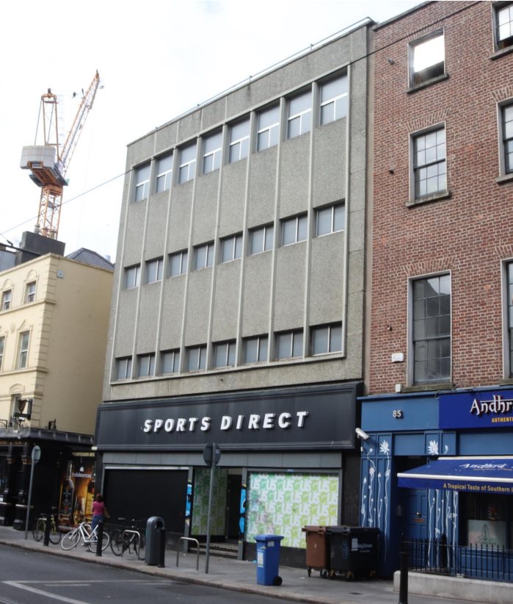
Unit 19-22, North Earl Street, Dublin
Side Entrance – Marlborough Street

Slide 3

Unit 19-22, North Earl Street, Dublin
Property Description
19–22 North Earl Street is a four-storey over basement mid-terrace building, prominently positioned in the heart of Dublin City Centre and widely recognised as a local landmark. The property enjoys dual frontage with an extensive main façade (18m+) to North Earl Street and a secondary access to Marlborough Street, adjacent to the Luas Cross City Line. This is a rare opportunity to secure a high-profile retail premises of scale in one of Dublin’s busiest commercial locations
Rent
The current rent is €1,045,271 per annum.
Viewings
Strictly by appointment only through sole leasing agents Cushman & Wakefield.
Rates
Commercial rates for this property is approximately €199,374 per annum.
Schedule of accommodation
The property comprises the following gross floor areas:
Insurance
The insurance is €19,749.
Lease terms
The property is held under a 15-year lease from 2019, subject to five-yearly rent reviews linked to CPI
Floor | Total Sq.m. | Total Sq.ft.
Basement | 711 | 7,653
Ground Floor | 1,408 | 15,155
Ground Floor Mezz | 359 | 3,864
First Floor | 1,123 | 12,088
Second Floor | 636 | 6,846
Third Floor | 595 | 6,405
Total | 4,832 | 52,011
Cushman & Wakefield
2 Cumberland Place Fenian Street Dublin 2
Ireland
+353 (0)1 639 9300
BER:
BER Number: 800460107

Slide 4
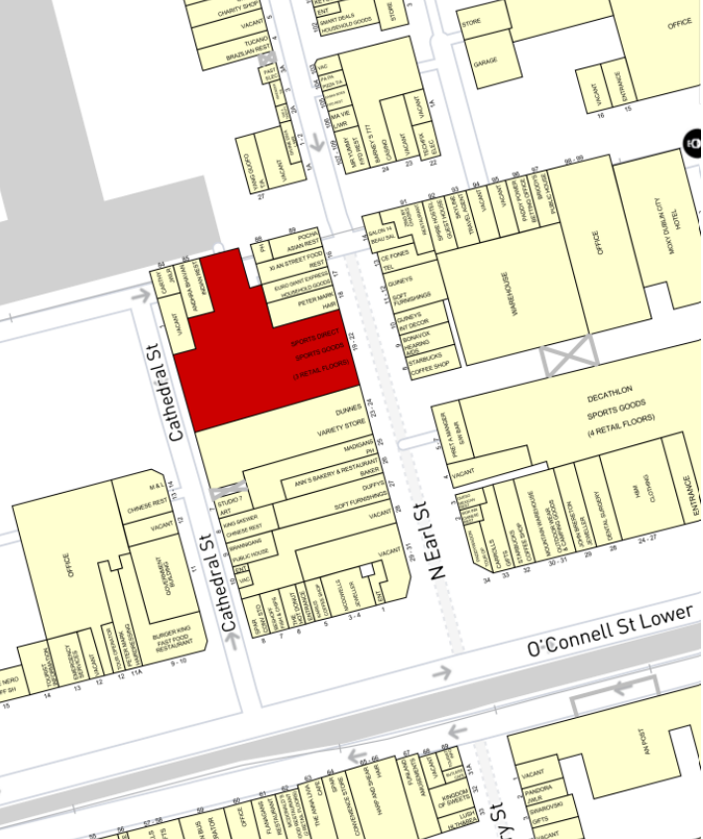
Unit 19-22, North Earl Street, Dublin

